Slide 1
Study for Finding CAR 173917131 – Team A
 | Team Review Criteria - Findings | Related to | Presented by
1 | ·Explain how/If the nonconformity is fully addressed in the analysis | Analysis | Simy Li
2 | ·Explain how/If the analysis supports the root cause statement
3 | ·Explain how/If the analysis supports the Scope of Nonconformance statement
4 | ·Explain why/If the Corrective Action Plan will prevent the recurrence of the nonconformity | Corrective Action | Simy Li
5 | ·Explain how/If the containment milestone “stopped the bleeding”
6 | ·Confirm that/If all corrective action milestones are aligned to each item of the corrective action plan
7 | ·Explain how/If the verification milestone confirmed the effective implementation of the corrective action plan | Verification | Matthew Kim

Slide 2
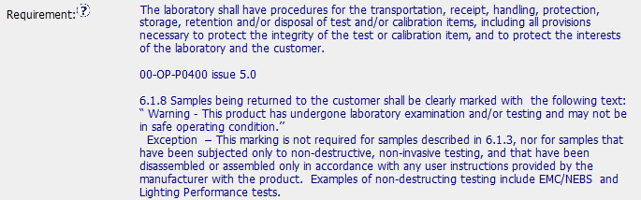
CAR# 173917131 - Background

Slide 3
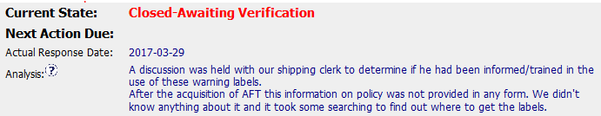

CAR# 173917131
 | Team Review Criteria - Findings
1 | ·Explain how/If the nonconformity is fully addressed in the analysis
2 | ·Explain how/If the analysis supports the root cause statement
3 | ·Explain how/If the analysis supports the Scope of Nonconformance statement
1. Analysis can address non-conformity but not clear. Analysis did ask why the shipping clerk didn’t apply warning labels to return samples. The reasons were due to no policy / guideline for this requirement , not being informed or trained and not easy to find the labels. Thus the causes of this noncompliance could be no communication, no policy / guideline or no training on the policy / guideline.
2. As analysis mentioned “didn’t know anything”, thus it can support the root cause statement “not communicated” though it’s not so clear.
3. Analysis cannot support the scope of nonconformance statement. Analysis didn’t mention where were the warning labels not being used.
3
Notes:
Highlight key points for below criteria:
•Explain how/If the nonconformity is fully addressed in the analysis
•Explain how/If the analysis supports the root cause statement
•Explain how/If the analysis supports the Scope of Nonconformance statement

Slide 4


CAR# 173917131
4 | ·Explain why/If the Corrective Action Plan will prevent the recurrence of the nonconformity
5 | ·Explain how/If the containment milestone “stopped the bleeding”
6 | ·Confirm that/If all corrective action milestones are aligned to each item of the corrective action plan
5. There is no clear containment action. The action that is to get the labels didn’t mean if shipping clerk will go through once the on-hand return samples as at the NC commencement date (2017-03-02) and put back warning labels on those return samples in order to stop the bleeding.
4. The CAP can prevent the recurrence of the NC as the root cause is not being communicated. Through training or briefing to shipping clerk, he/she should know the warning label has to be applied to return samples. But the CAR owner needs to think how to ensure every new staff who will handle sample disposal know to apply warning label.
6. Corrective action milestones were not aligned to each item of the corrective action plan. There is owner verification milestone that was missed to be mentioned in the CAP. The verification milestone is good to provide a list of samples checked to have labels when returned to customer and date of return. However, this looks like containment action.
Notes:
Highlight key points for below criteria:
•Explain why/If the Corrective Action Plan will prevent the recurrence of the nonconformity
•Explain how/If the containment milestone “stopped the bleeding”
•Confirm that/If all corrective action milestones are aligned to each item of the corrective action plan

Slide 5
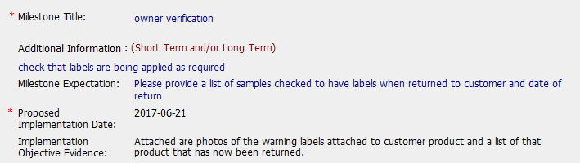
CAR# 173917131
7 | ·Explain how/If the verification milestone confirmed the effective implementation of the corrective action plan
7. The verification milestone can only confirm the implementation of the CAP (i.e. all return samples were applied warning labels) was completed on 2017-04-28. However, the objective of owner’s verification milestone is to verify the effectiveness of actions taken. For this, it needs to be monitored for 2 or 3 consecutive months after corrective action. Therefore, we recommend CAR owner to close it as planned without closing earlier.
Notes:
Highlight key points for below criteria:
•Explain how/If the verification milestone confirmed the effective implementation of the corrective action plan

Slide 6
CAR# 173917131 – CAR Review Criteria Check
CAR Review Criteria | Fully | Partially | Not at all | N/A
•Is the nonconformity fully addressed in the analysis? | X
•Does the analysis support the root cause statement? | X
•Does the analysis support the Scope of Nonconformance statement |  |  | X
•Will the Corrective Action Plan prevent recurrence of the nonconformity? | X
•Did the containment milestone “stop the bleeding”? |  |  | X
•Are corrective action milestones aligned to each item of the corrective action plan? |  | X
•Did the verification milestone confirm the effective implementation of the corrective action plan? |  | X

Slide 7
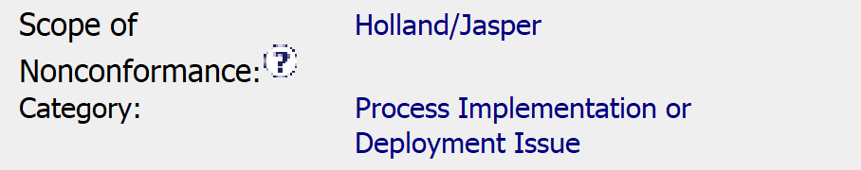
CAR 173917131 FINDING
1. Explain how/if the nonconformity is fully addressed in the analysis.
The analysis does not include the full list of stakeholders involved in the analysis. The way the analysis is documented it gives the impression that it jumped right to the corrective action without describing how they arrived at the root cause. Why was training and labels not provided?
2. Explain how/if the analysis supports the root cause statement.
The analysis does not clearly arrive at a root cause or describe why the need for labels was not communicated to the shipping clerk. It is important to understand why to prevent a reoccurrence.
Explain how/if the analysis supports the Scope of Nonconformance statement.
The nonconformance and the scope of the nonconformance indicates Holland/Jasper. The analysis does not provide any clear information on the scope, but it does indicate something about acquisition of AFT.

Slide 8

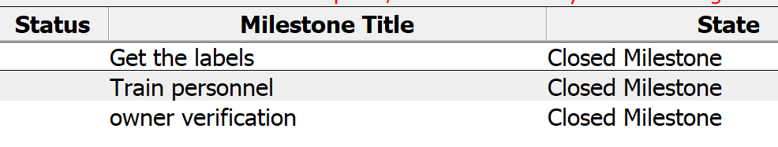

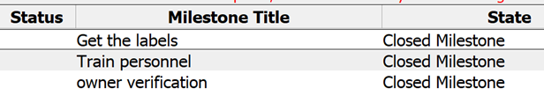
CAR 173917131 FINDING
4. Explain how/if CA Plan prevents recurrence of the nonconformity.
The CA plan is to train personnel involved and provide the labels. If this is the root cause (lack of training and access to labels) then it should prevent recurrence.
5. Explain how/if the containment milestone "stopped the bleeding“.
There was no clear containment milestone noted on the CAR.
6. Explain how/if the CA milestones are aligned to each item of the CA plan.
There was a millstone for the training and a milestone for the labels which agree with what was stated in the CA.

Slide 9
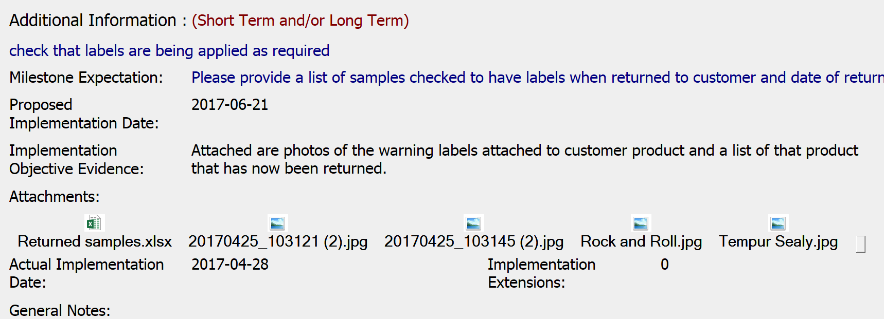
CAR 173917131 FINDING
7. Explain how/if the verification milestone confirmed the effective implementation of the CA plan.
The verification milestone included photos showing that labels are now being applied as well as a list of the samples that were returned. This provided evidence that the training was effective and that the individuals have access to the required labels.

